Slide 1



2021 NBA Playoffs
Louise Lalescu ISTA 350 Final Project
GitHub Repo

Slide 2
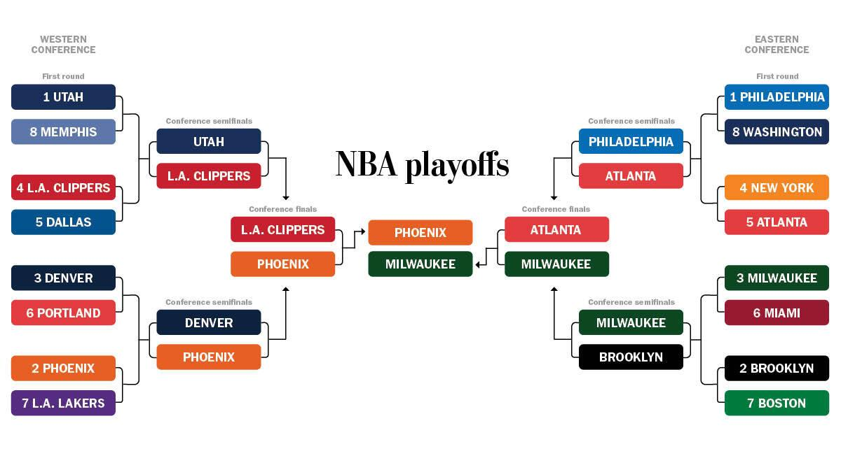

Slide 3



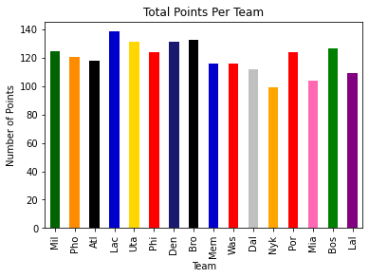












Playoff Point Breakdown
Atl - Atlanta Hawks
Bos - Boston Celtics
Bro - Brooklyn Nets
Dal - Dallas Mavericks
Den - Denver Nuggets
Lac - Los Angeles Clippers
Lal - Los Angeles Clippers
Mem - Memphis Grizzlies
Mia - Miami Heat
Mil - Milwaukee Bucks
Nyk - New York Knicks
Phi - Philadelphia 76ers
Pho - Phoenix Suns
Por - Portland Trail Blazers
Uta - Utah Jazz
Was - Washington Wizards

Slide 4
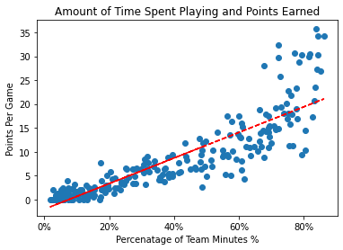
Time Played and Points Per Game
Min Playing%- Percentage of team mins used by player while on the Floor

Slide 5


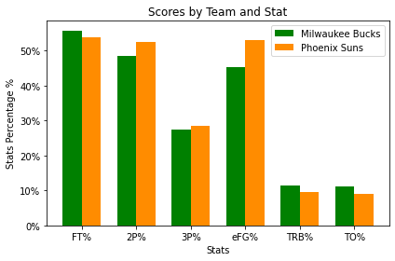
VS
FT% - Free Throw %
2P% - 2 Point %
3P% - 3 Point %
eFG% - eFG% Formula=(FGM+ (0.5 x 3PM))/FGA
TRB%- Total rebound percentage is estimated percentage of available rebounds grabbed
TO% - metric that estimates the number of turnovers a player commits per 100 possessions

Slide 6

Giannis Free Throw Counting

Slide 7


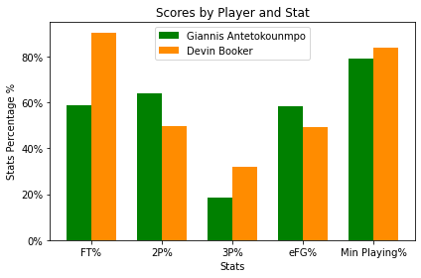
Giannis vs Devin
FT% - Free Throw %
2P% - 2 Point %
3P% - 3 Point %
eFG% - eFG% Formula=(FGM+ (0.5 x 3PM))/FGA
Min Playing%- Percentage of team mins used by player while on the Floor

